Slide 1
Supervised Learning
26 November 2017
Pejanten Barat, Pasarminggu, Jakarta Selatan
Markus Paramahasti

Slide 2
What is Supervised ?
Supervised is about :
→Classification task
→Regression task
Both are Learning from (labelled) data.
Example :

Slide 3
Theoretical Machine Learning
Component of ML :
*Hypotheses Space → Model Representation
*Evaluation → differentiate which is the better among the models
*Optimization → search the optimum value

Slide 4
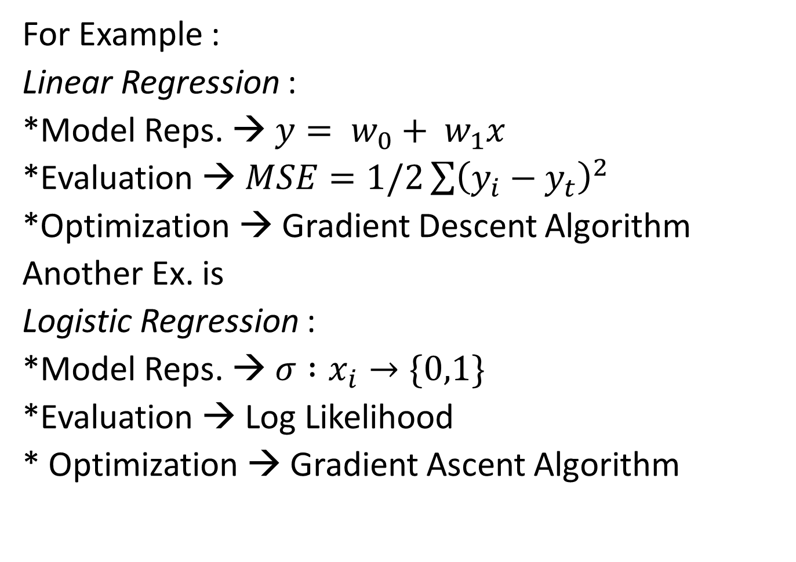
For Example :
Linear Regression :
*Model Reps. → $y= w_{0}+ w_{1}x$
*Evaluation → $MSE=1/2\sum{{\left(y_{i}−y_{t}\right)}^{2}}$
*Optimization → Gradient Descent Algorithm
Another Ex. is
Logistic Regression :
*Model Reps. → $σ :x_{i}→\{0,1\}$
*Evaluation → Log Likelihood
* Optimization → Gradient Ascent Algorithm

Slide 5
The Task & Goals
Classification : The ability to differentiate what the new data belongs to (the class)
Example :
Regression : The ability to infer/assesing the value
Example :

Slide 6
Example of applicatons
Retail
Banking
Medical
Security (Fraud detection)
Internet
Etc.

Slide 7
The Supervised Model and Algorithms
K-Nearest Neighbors
Linear Regression
Polynomial Regression
Logistic Regression
Support Vector Machines

Slide 8
Next Time…
Non Separable Datasets
Decission Tree
Kernel Methods
Random Forest
Ensemble Methods
Deep Learning
And so on…

Slide 9
Learning ML
Textbooks :
Introduction to Statistical Learning (Tsibharani)
Pattern Recognition and ML (Bishop)
Video lecture
Community/Study Group
Stay Continue Learning

Slide 10
Try to Code
Install numpy, pandas, matplotlib :
Install scikit learn:

